Slide 1
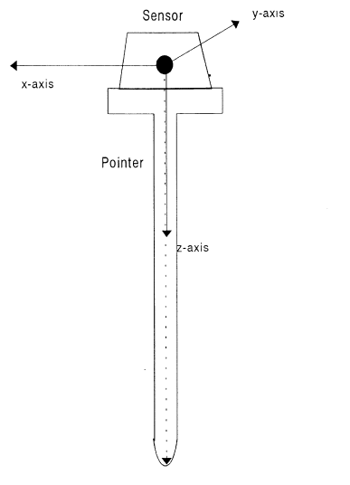
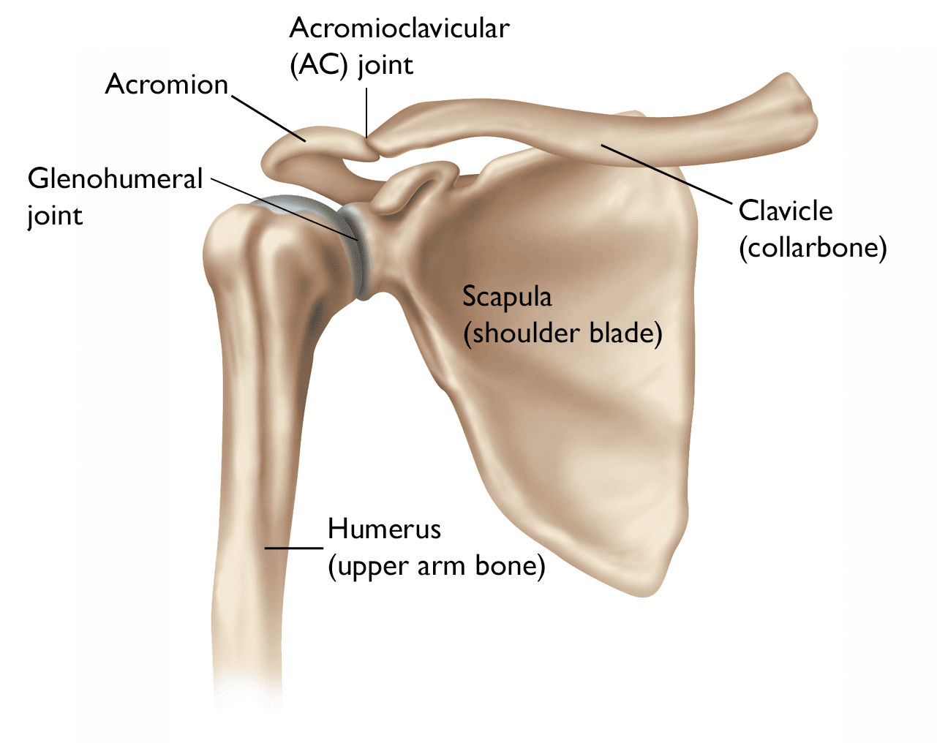

Slide 2
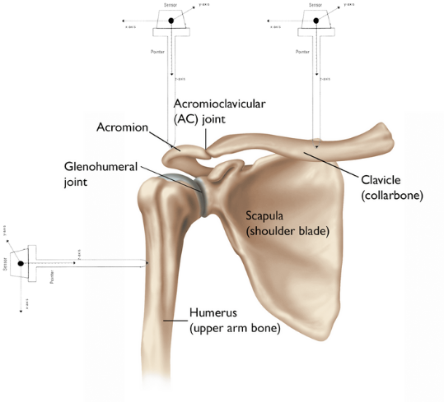
x
IMU sensor
2
3
*0
1

Slide 3
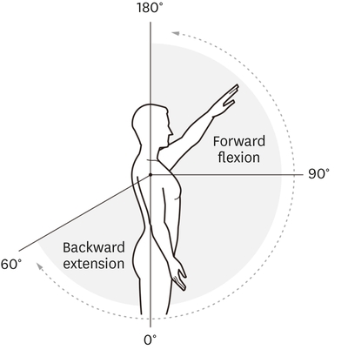
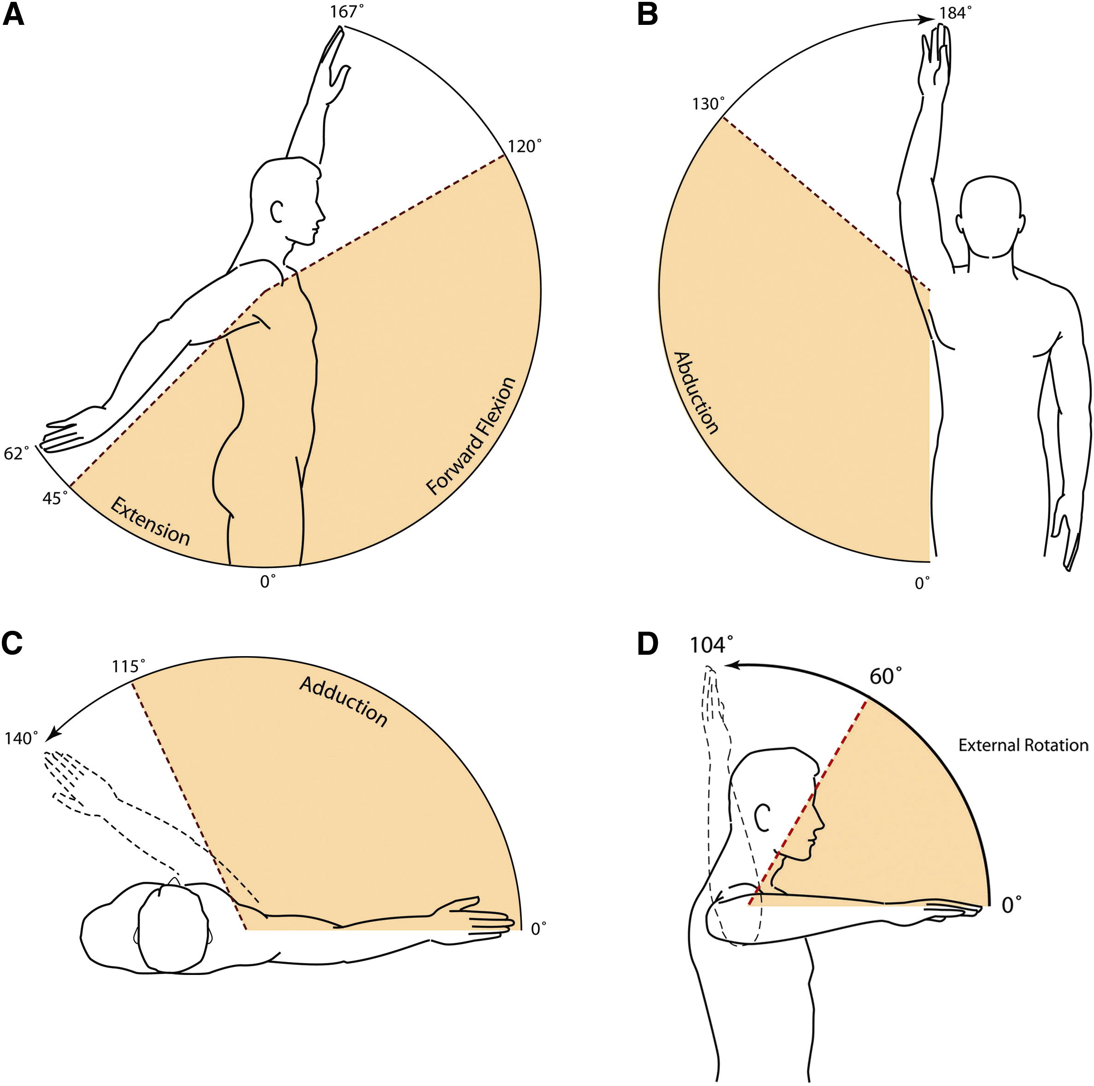
Test Condition
FF
0*
30*
60*
90*
120*
150*
AB
0*
30*
60*
90*
120*
150*
AD
0*
30*
60*

Slide 4
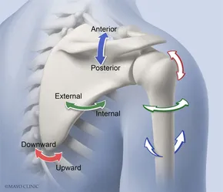
Expect result

Slide 6
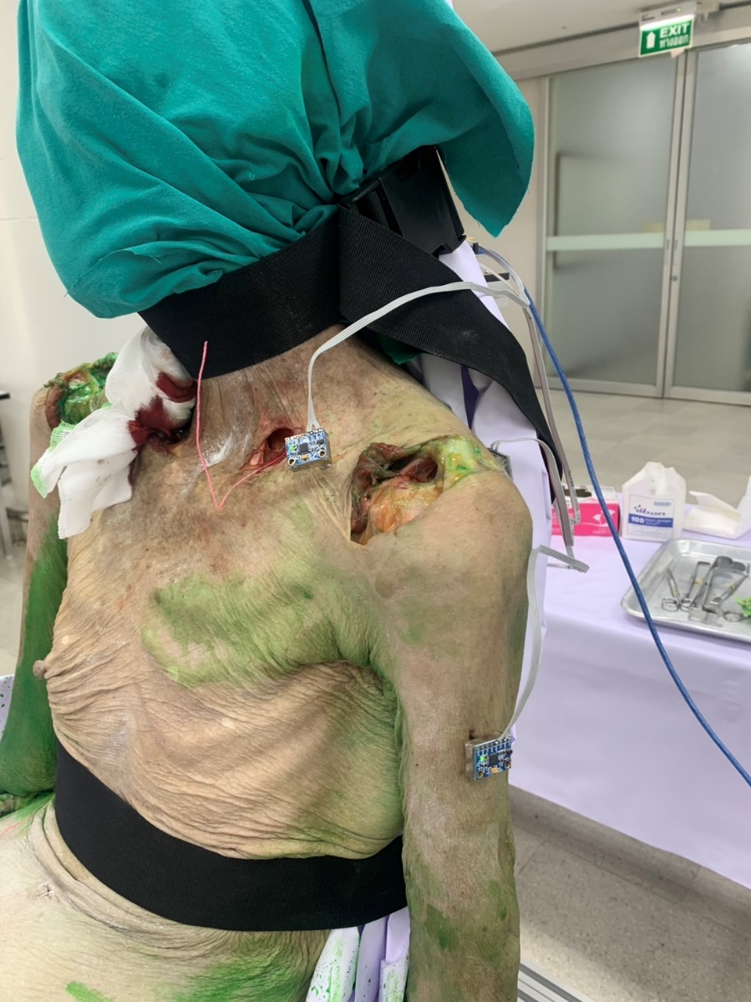
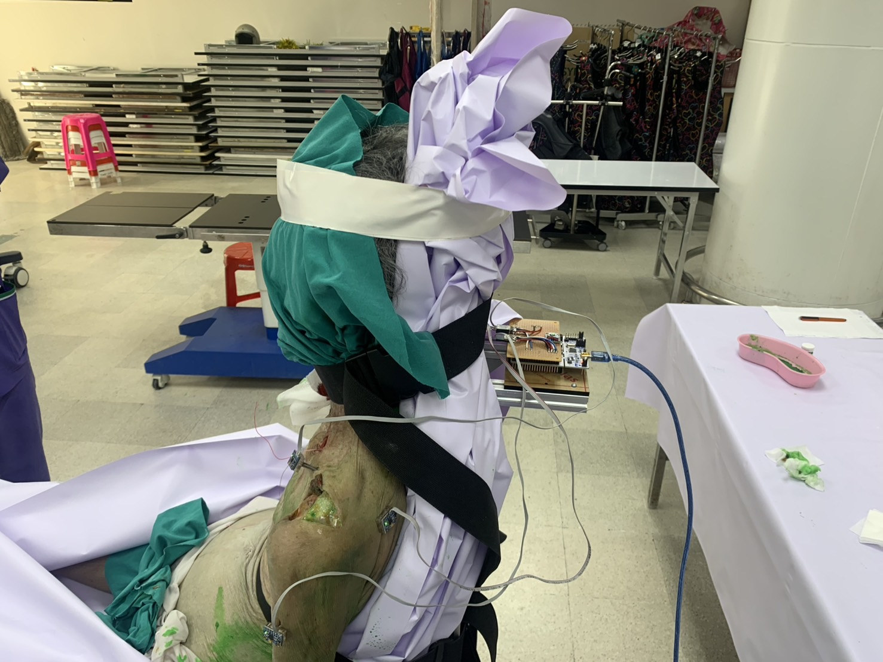

Slide 7
Library Numerical
https://www.openblas.net/
https://www.intel.com/content/www/us/en/developer/tools/oneapi/onemkl.html

